Slide 1
Topics to be Covered:
Java MouseListener Interface
Java MouseMotionListener Interface
Java WindowListener Interface
Java Adapter Classes

Slide 2
Java MouseListener Interface

Slide 3
Java MouseListener Interface
The Java MouseListener is notified whenever you change the state of the mouse.
It is notified against MouseEvent. The MouseListener interface is found in java. awt. event package.
Methods of MouseListener Interface :
public abstract void mouseClicked(MouseEvent e);
public abstract void mouseEntered(MouseEvent e);
public abstract void mouseExited(MouseEvent e);
public abstract void mousePressed(MouseEvent e);
public abstract void mouseReleased(MouseEvent e);

Slide 4
Java MouseListener Interface: Example 01
import java.awt.*;
import java.awt.event.*;
public class MouseEx1 extends Frame implements MouseListener{
Label l;
MouseEx1()
{
addMouseListener(this);
l=new Label();
l.setBounds(20,50,100,20);
add(l);
setSize(300,300);
setLayout(null);
setVisible(true);
}
public static void main(String[] args)
{
new MouseEx1();
}
}
public void mouseClicked(MouseEvent e)
{
l.setText("Mouse Clicked");
}
public void mouseEntered(MouseEvent e)
{
l.setText("Mouse Entered");
}
public void mouseExited(MouseEvent e)
{
l.setText("Mouse Exited");
}
public void mousePressed(MouseEvent e)
{
l.setText("Mouse Pressed");
}
public void mouseReleased(MouseEvent e)
{
l.setText("Mouse Released");
}

Slide 5
Java MouseListener Interface: Example 02
import java.awt.*;
import java.awt.event.*;
public class MouseEx2 extends Frame implements MouseListener
{
MouseEx2()
{
addMouseListener(this);
setSize(300,300);
setLayout(null);
setVisible(true);
}
public void mouseClicked(MouseEvent e)
{
Graphics g=getGraphics();
g.setColor(Color.BLUE);
g.fillOval(e.getX(),e.getY(),30,30);
}
public void mouseEntered(MouseEvent e) {}
public void mouseExited(MouseEvent e) {}
public void mousePressed(MouseEvent e) {}
public void mouseReleased(MouseEvent e) {}
public static void main(String[] args)
{
new MouseEx2();
}
}

Slide 6
Java MouseMotionListener Interface

Slide 7
Java MouseMotionListener Interface
The Java MouseMotionListener is notified whenever you move or drag mouse.
It is notified against MouseEvent. The MouseMotionListener interface is found in java.awt.event package.
Methods of MouseMotionListener Interface :
public abstract void mouseDragged(MouseEvent e);
public abstract void mouseMoved(MouseEvent e);

Slide 8
Java MouseMotionListener Interface: Example 01
import java.awt.*;
import java.awt.event.*;
public class MouseMotionEx1 extends Frame implements MouseMotionListener
{
MouseMotionEx1()
{
addMouseMotionListener(this);
setSize(300,300);
setLayout(null);
setVisible(true);
}
public void mouseDragged(MouseEvent e)
{
Graphics g=getGraphics();
g.setColor(Color.BLUE);
g.fillOval(e.getX(),e.getY(),20,20);
}
public void mouseMoved(MouseEvent e) {}
public static void main(String[] args)
{
new MouseMotionEx1();
}
}

Slide 9
Java MouseListener Interface: Example 02
import java.awt.*;
import java.awt.event.*;
public class MouseEx2 extends Frame implements MouseListener
{
MouseEx2()
{
addMouseListener(this);
setSize(300,300);
setLayout(null);
setVisible(true);
}
public void mouseClicked(MouseEvent e)
{
Graphics g=getGraphics();
g.setColor(Color.BLUE);
g.fillOval(e.getX(),e.getY(),30,30);
}
public void mouseEntered(MouseEvent e) {}
public void mouseExited(MouseEvent e) {}
public void mousePressed(MouseEvent e) {}
public void mouseReleased(MouseEvent e) {}
public static void main(String[] args)
{
new MouseEx2();
}
}

Slide 10
Java WindowListener Interface

Slide 11
Java WindowListener Interface
The Java WindowListener is notified whenever you change the state of window. It is notified against WindowEvent. The WindowListener interface is found in java.awt.event package.
Methods of WindowListener interface
SNo | Method Name | Description
1. | public abstract void windowActivated (WindowEvent e); | It is called when the Window is set to be an active Window.
2. | public abstract void windowClosed (WindowEvent e); | It is called when a window has been closed as the result of calling dispose on the window.
3. | public abstract void windowClosing (WindowEvent e); | It is called when the user attempts to close the window from the system menu of the window.
4. | public abstract void windowDeactivated (WindowEvent e); | It is called when a Window is not an active Window anymore.
5. | public abstract void windowDeiconified (WindowEvent e); | It is called when a window is changed from a minimized to a normal state.
6. | public abstract void windowIconified (WindowEvent e); | It is called when a window is changed from a normal to a minimized state.
7. | public abstract void windowOpened (WindowEvent e); | It is called when window is made visible for the first time.

Slide 12
Java WindowListener Interface: Example
import java.awt.*;
import java.awt.event.WindowEvent;
import java.awt.event.WindowListener;
public class WindowEx extends Frame implements WindowListener
{
WindowExample()
{
addWindowListener(this);
setSize (400, 400);
setLayout (null);
setVisible (true);
}
public static void main(String[] args)
{
new WindowExample();
}
public void windowActivated (WindowEvent w)
{
System.out.println("activated");
}
public void windowClosed (WindowEvent w) {
System.out.println("closed");
}
public void windowClosing (WindowEvent w) {
System.out.println("closing");
dispose();
}
public void windowDeactivated (WindowEvent w){
System.out.println("deactivated");
}
public void windowDeiconified (WindowEvent w) {
System.out.println("deiconified");
}
public void windowIconified(WindowEvent w) {
System.out.println("iconified");
}
public void windowOpened(WindowEvent arg0) {
System.out.println("opened");
}
}

Slide 13
Java Adapter Classes

Slide 14
Java Adapter Classes
Java adapter classes provide the default implementation of listener interfaces. If you inherit the adapter class, you will not be forced to provide the implementation of all the methods of listener interfaces. So it saves code.
Advantages of using Adapter classes:
It assists the unrelated classes to work combinedly.
It provides ways to use classes in different ways.
It increases the transparency of classes.
It provides a way to include related patterns in the class.
It provides a pluggable kit for developing an application.
It increases the reusability of the class.
The adapter classes are found in java.awt.event, java.awt.dnd and javax.swing.event packages.

Slide 15
java.awt.event Adapter classes
SNo | Adapter class | Listener interface
1. | WindowAdapter | WindowListener
2. | KeyAdapter | KeyListener
3. | MouseAdapter | MouseListener
4. | MouseMotionAdapter | MouseMotionListener
5. | FocusAdapter | FocusListener
6. | ComponentAdapter | ComponentListener
7. | ContainerAdapter | ContainerListener

Slide 16
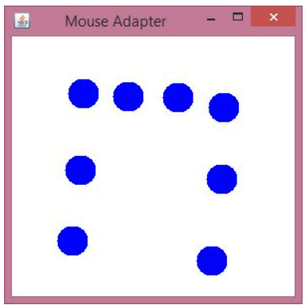
Java MouseAdapter Class: Example
import java.awt.*;
import java.awt.event.*;
public class MouseAdapterExample extends MouseAdapter
{
Frame f;
MouseAdapterExample()
{
f = new Frame ("Mouse Adapter");
f.addMouseListener(this);
f.setSize (300, 300);
f.setLayout (null);
f.setVisible (true);
}
public void mouseClicked (MouseEvent e)
{
Graphics g = f.getGraphics();
g.setColor (Color.BLUE);
g.fillOval (e.getX(), e.getY(), 30, 30);
}
public static void main(String[] args)
{
new MouseAdapterExample();
}
}
Output:

Slide 17
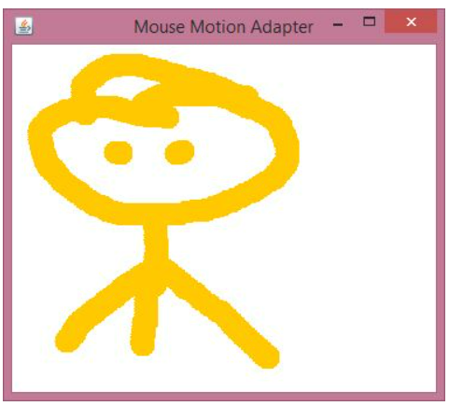
Java MouseMotionAdapter Class: Example
import java.awt.*;
import java.awt.event.*;
public class MouseMotionAdapterExample extends MouseMotionAdapter
{
Frame f; // object of Frame class
MouseMotionAdapterExample()
{
f = new Frame ("Mouse Motion Adapter"); // Setting title
f.addMouseMotionListener (this); // adding MouseMotionListener to the Frame
f.setSize (300, 300);
f.setLayout (null);
f.setVisible (true);
}
public void mouseDragged (MouseEvent e)
{
Graphics g = f.getGraphics();
g.setColor (Color.ORANGE); // setting the color of graphics object
g.fillOval (e.getX(), e.getY(), 20, 20); // setting the shape of graphics object
}
public static void main(String[] args)
{
new MouseMotionAdapterExample();
}
}
Output:

Slide 18
Thank You

